Slide 1

Energy-efficient ultra-sensitive magnetoelectric sensors for magnetocardiography and magnetoencephalography
JRF to SRF
M. Mohanlal Naik
Roll: 1910704, Email: mnaik19@iiserb.ac.in
Electrical Engineering and Computer Science (EECS) Dept.
Indian Institute of Science Education and Research (IISER) Bhopal
Advisor: Dr. Kuntal Roy, Email: kuntal@iiserb.ac.in
23-Oct-2021

Slide 2
Contents
Motivation
Introduction
Human brain
Examples of Neuromagnetic fields
Neural basis of magnetoencephalography
Neural generation of electromagnetic fields
Forward and inverse problems
Instrumentation for magnetoencephalography
Ultrasensitive multiferroic sensor
Interfacial perpendicular anisotropy between oxide and ferromagnet
Demonstration of ultrasensitive piezoelectric-magnetostrictive sensors
Instruments
Sputtering
Vibrating sample magnetometer
Stress and strain machine
Electromagnet
Ultrasensitive measurement instruments

Slide 3
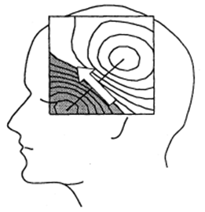
Motivation: Ultrasensitive sensors
Ultrasensitive magnetic sensors
Magnetocardiography (MCG) Magnetoencephalography (MEG)
Detectable signal at room-temperature is a challenge
Noise-cancellation techniques
Multiferroic nanostructures
Magnetostrictive
Non-invasive studies of human brain
Piezoelectric
Strain
Voltage
Piezoelectric characterization
COMSOL modeling
Material/Stress testing
Strain gauge
Interfacial anisotropy characterization
Noise-cancellation techniques
Differential amplifiers
femto-Tesla
Magnetic Field Sensing
M. Hamalainen et al,
Rev. Mod. Phys. 65, 413 (1993)
Seizure detection
Aging technologies
Notes:
Sensor is a transducer, it convert the magnetic field energy into electric field energy
For piezoelectric characterization we have to use COMSOL and characterize stress and strain
MEG –Femto tesla
MCG- pico tesla

Slide 4
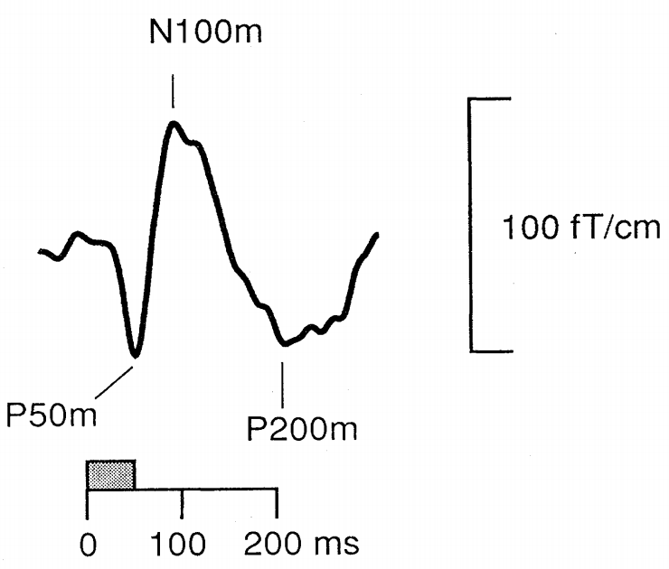
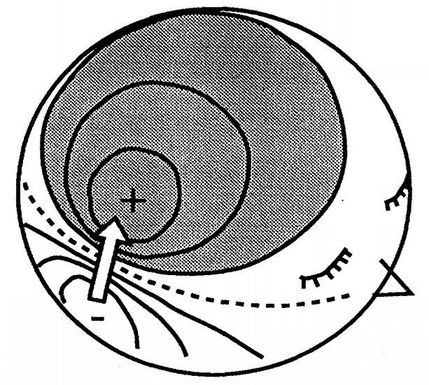
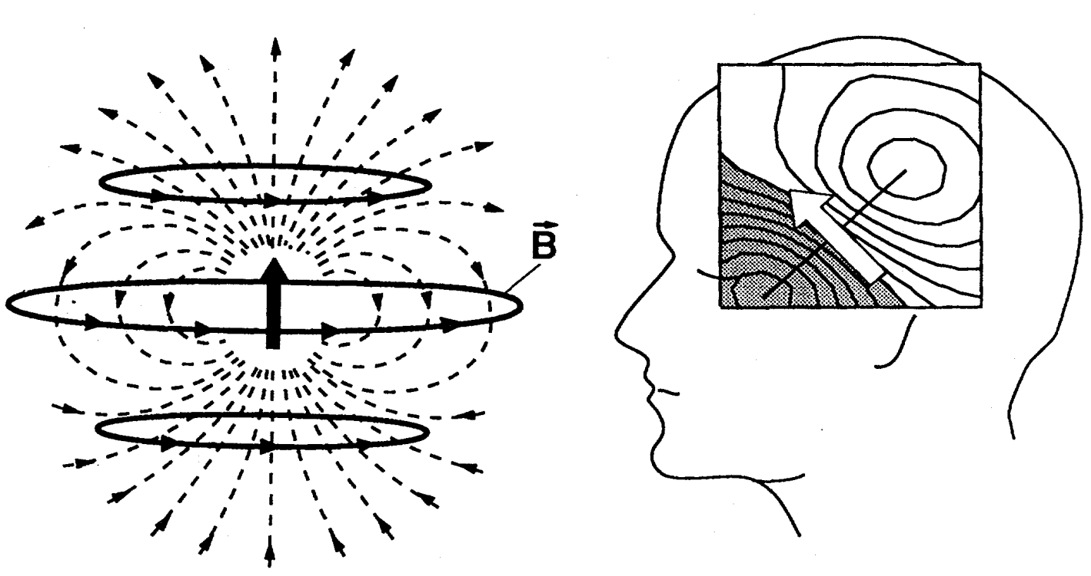
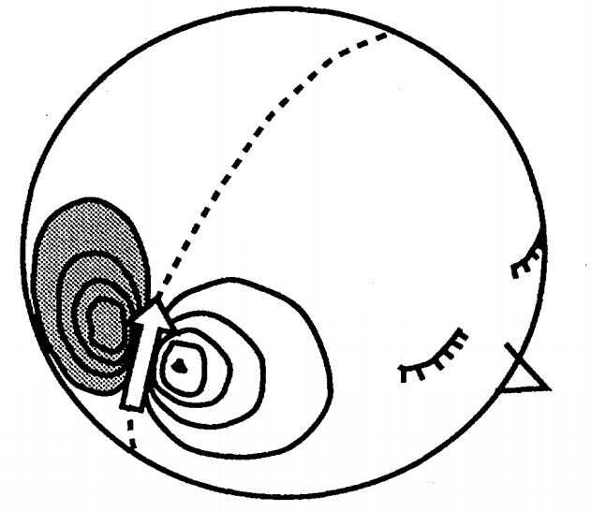
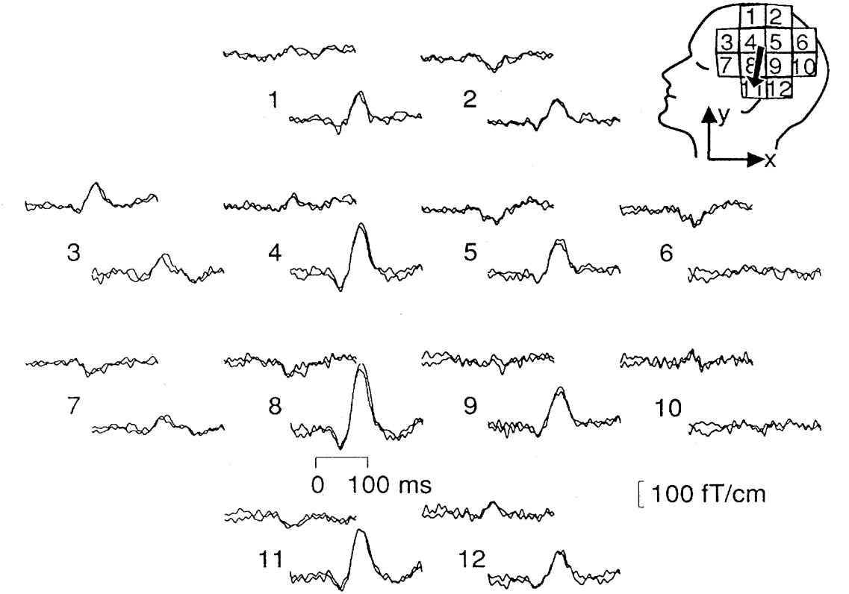
Introduction
First measurement of magnetic field of a human brain was captured by David Cohen (Cohen, 1972) from MIT
P (or) N → +/- Electric potential from EEG
100 → Time period of signal in milli second
m → Magnetic field
Electric potential
Magnetic field of an auditory response, measured by MEG
Magnetic field
Notes:
Each circle has same potential

Slide 5
Current dipole
Point charge is a charge located in single point in space

Slide 6
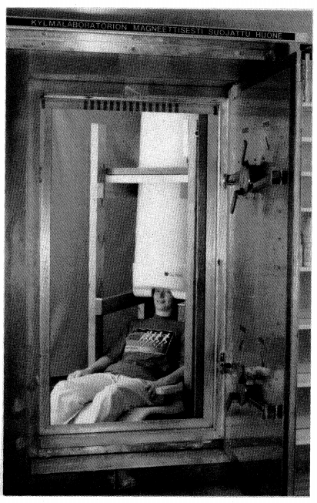
Limitations of current technology (SQUID)
Superconducting quantum interference device (SQUID)
People suffering from unconscious (coma) due to brain injury
Active brain of unconscious people fail to communicate to the world
Sensors to observe the active brain
Magnetoencephalography (MEG)
Electroencephalography (EEG)
SQUID working principle ?
Size is big and operating cost is high
Need cold environment like helium chamber (about 4 kelvin) with superconductors
Need magnetic shielded room to minimize external noise
Minimum duration of MEG-EEG recording sessions is about 30 min
MEG device with shielded room

Slide 7
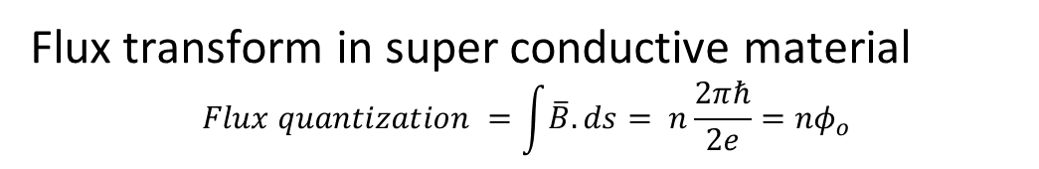
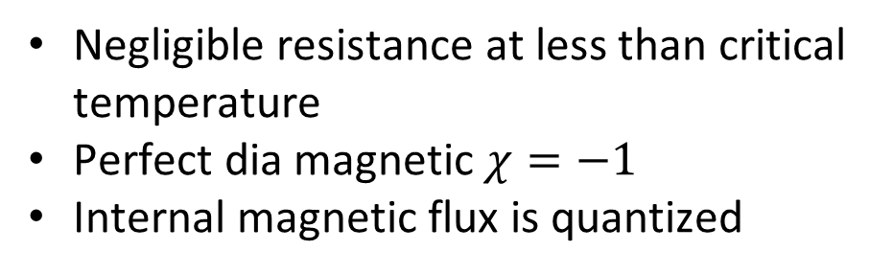
Working principle of SQUID
Negligible resistance at less than critical temperature
Perfect dia magnetic $χ=−1$
Internal magnetic flux is quantized
Flux transform in super conductive material
$$Flux quantization =\int{\overline{B}.ds}= n\frac{2πℏ}{2e}=nφ_{o}$$

Slide 8

Biomedical instruments
This are techniques
Non invasive MEG and EEG measure signals from the same synchronized neural activity in the brain
Electroencephalography (EEG): Capture electrical potential difference b/w two locations on scalps
Magnetoencephalography (MEG): Measure neuromagnetic signals from the brain
Electrocardiography (ECG): Non invasive device, helps to measure electric potential around the heart
Magnetocardiography (MCG): Instead of brain, heart is being measured
Heart magnetic fields are 5000 times greater than brain
Diagnose and monitor conditions affecting the heart

Slide 9
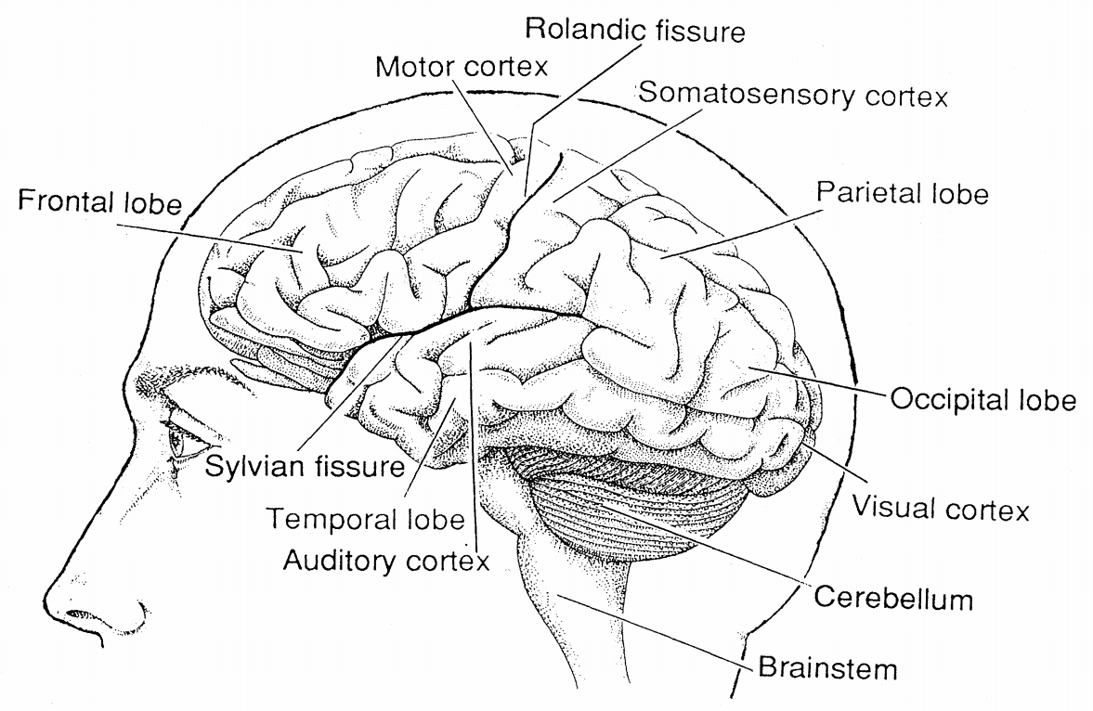
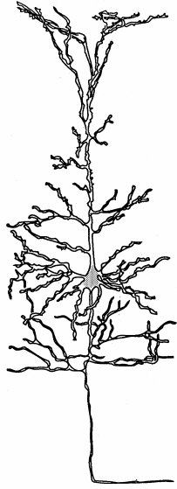
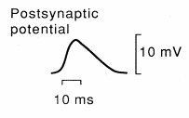
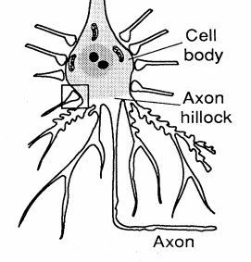
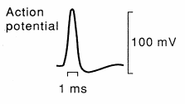
Neural basis of magnetoencephalography
Improve presentation
MEG concentrates on cerebral cortex (present on top layer of brain): 2-4 mm thick and 2500 cm²
Neuron
Cell body (Soma)
Notes:
Generally we have two hemisphere and four in our brain,
Two hemisphere separated by longitudinal fissure and communicate by carpus callosum (group of neurons)
Four lobes separated by particular fissure and communicate by the neuron, which have the connection between white matter() and grey matter(occupied by the neurons )
____
This is the neuron with axon and this is the cell body
They are lot of other neuron cells connected to the cell body and shown cell signal receiver called dendrites
Electrical voltages generated in the neuron by the chemical gradient

Slide 10
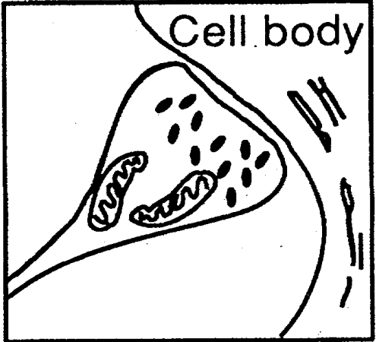
Neurons
Transfers information as electrical signals, by excitable tissues (Na⁺, K⁺ and Cl⁻)
At least 10¹⁰ neurons and 10¹⁴ synapses/interconnections in cerebral cortex
Axon: Long fiber that carries the nerve impulses
Dendrites: Receive the stimuli
Glial cell: Glue around neuron, helps to maintain proper concentration of ions
Soma (Neuron body): Contains genetic material in the form of chromosomes
Oligodendrocytes: Acts as a insulating myelin sheath around neuron, helps to speeding signal transmission in central nervous system

Slide 11
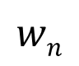
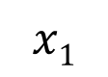
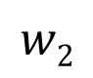

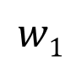
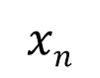
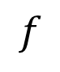
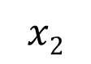
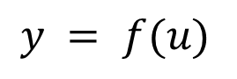
Biological neuron vs Artificial neuron
Biological neuron
Artificial neuron
Dendrites
Dendrites
Input
$$x1$$
Soma
(Neuron body)
Summation & Activation function
$$w1$$
$$x2$$
.
.
.
$$Σ$$
$$y = f(u)$$
$$w2$$
$$f$$
Axon
Output
$$xn$$
$$wn$$

Slide 12
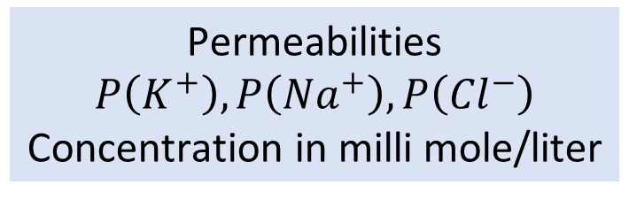
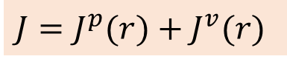
Ion mechanisms
Volume and ohmic currents
How concentration gradient is maintained
Get clarity on membrane
Barrier vs well
Why – in potential
Understand current and radius
Calculation of current ?
Diffusion current equation
How the signal propagate in particular direction
Goldman's (1943), membrane potential equation
$$V=\frac{K_{B}T}{\left|e\right|}\ln\left[ \frac{{P\left(K^{+}\right)C}_{{Ext,K}^{+}} +{P\left({Na}^{+}\right)C}_{{Ext,Na}^{+}}+{P\left({Cl}^{−}\right)C}_{{Int,Cl}^{−}}}{{P\left(K^{+}\right)C}_{{Int,K}^{+}} +{P\left({Na}^{+}\right)C}_{{Int,Na}^{+}}+{P\left({Cl}^{−}\right)C}_{{Ext,Cl}^{−}}}\right]$$
Permeabilities $P\left(K^{+}\right),P\left({Na}^{+}\right),P\left({Cl}^{−}\right)$
Concentration in milli mole/liter
$$V=−0.0698 Volts \sim −70mV$$
Current = 1 e-6 A, Radius = 100 e-6 m
Volume current
5 K⁺
140 K⁺
140
Na⁺
20 Na⁺
Ohmic current
20 Cl⁻
Direction of propagation
120 Cl⁻
$$J=J^{p}(r)+J^{v}(r)$$
Notes:
Goldman derived an voltage equation, on ion diffusion through the membrane. At equilibrium membrane potential of -70 mV, Na+ and Cl- has higher concentration on extra cellular membrane, where as in case of K+, concentration is higher in intra cellular membrane. the permeability will change with ion diffusion through the channels.

Slide 13
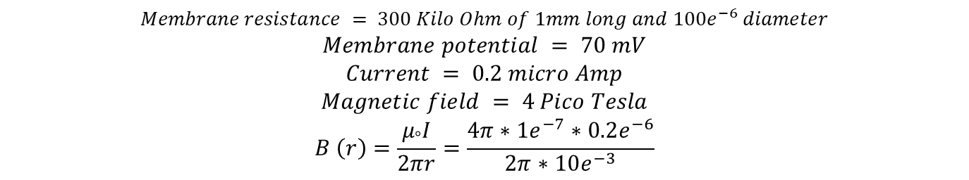
$$Membrane resistance = 300 Kilo Ohm of 1mm long and 100e^{−6} diameter$$
$$Membrane potential = 70 mV$$
$$Current = 0.2 micro Amp$$
$$Magnetic field = 4 Pico Tesla$$
$$B \left(r\right)=\frac{μ_{°}I}{2πr}=\frac{4π∗1e^{−7}∗0.2e^{−6}}{2π∗10e^{−3}}$$

Slide 14
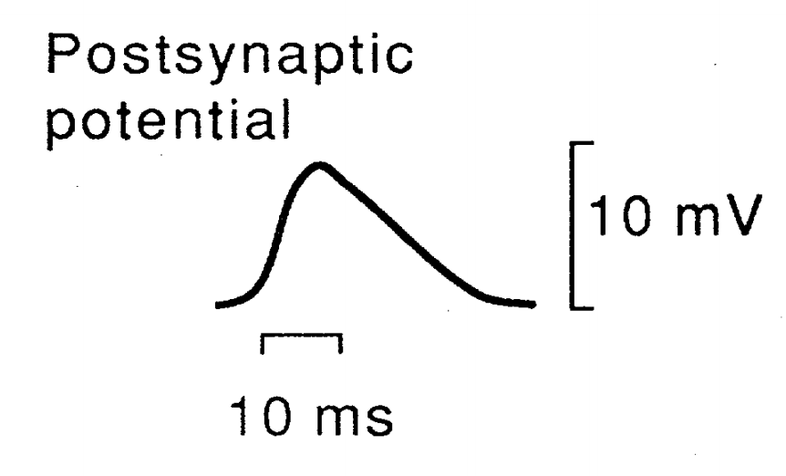
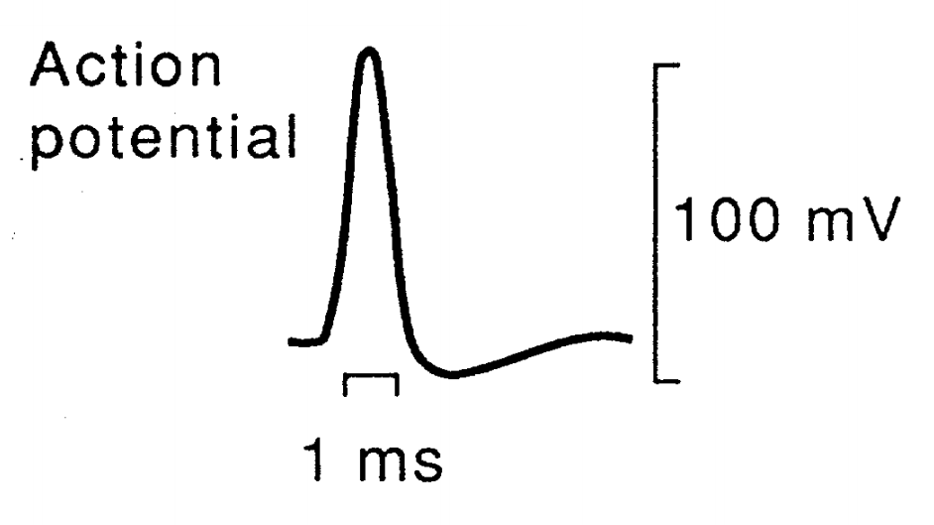
Electrical potential in the neuron
Releasing transmitter molecules
Change in permeability
Change in membrane potential
Concise slide on signal propagation
Excitatory synapse
Inhibitory synapse
+
Inflow Na⁺ ends
Outflow K⁺ dominates
-
Depolarization
Repolarization
Sufficiently depolarized postsynaptic neurons cause action potential
Na⁺ inflow begins

Slide 15
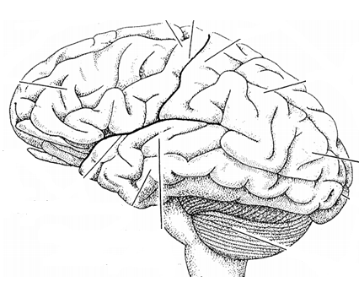
Equivalent current dipole
Why magnetically can’t the radial dipole
Current dipole is an equivalent source of electric field and magnetic fields
Simultaneous and synchronous active group of neurons create equivalent current dipole
Tangential dipole are magnetically active but electrically silent
R
T
Radial dipole are electrically active but magnetically silent
Notes:
Theoretically prediction is that --> Radial dipole cant produce the magnetic field out of spherical shell but practically our head is not spherical in shape

Slide 16
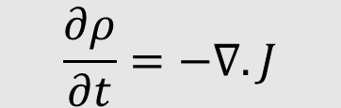
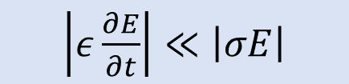
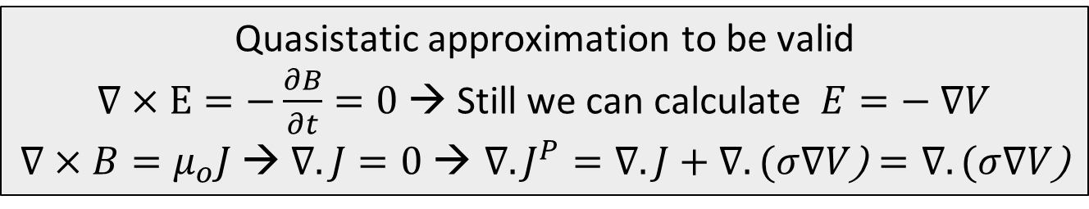
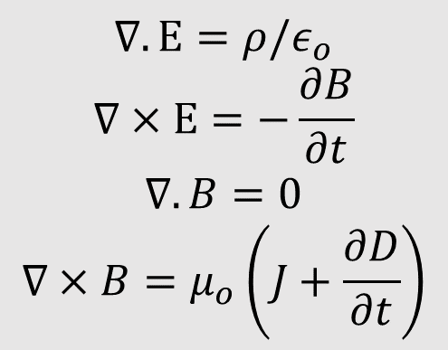
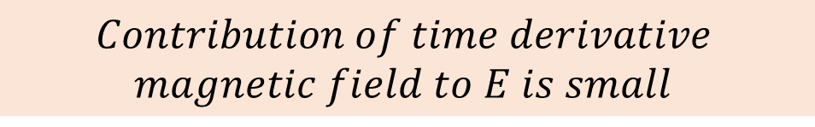
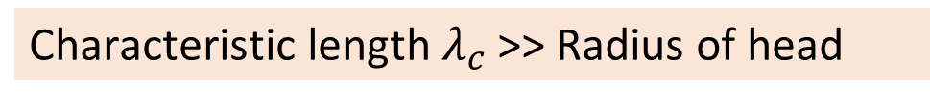

Neural generation of electromagnetic field
Maxwell’s equations and continuity equation help
to calculate the E and B of the brain tissue
when conductivity and electric current are known
$$\frac{∂ρ}{∂t}=−∇.J$$
$\left|ε\frac{∂E}{∂t}\right|≪$ $\left|σE\right|$
Understand input and output of the model
Understand cross product and dot product
$$∇.Ε={ρ/ε}_{ο}$$
$$∇×Ε=−\frac{∂B}{∂t}$$
$$∇.B=0$$
$$∇×B=μ_{ο}\left(J+\frac{∂D}{∂t}\right)$$
$$Time derivatives are small$$
$$compared to ohmic current$$
Characteristic length$λ_{c}$>> Radius of head
$$Contribution of time derivative$$
$$magnetic field to E is small$$
Quasistatic approximation to be valid
$∇×Ε=−\frac{∂B}{∂t}=0$→ Still we can calculate $E=− ∇V$
$∇×B=μ_{ο}J$ → $∇.J=0 \text{→} ∇.J^{P}=∇.J+∇.(σ∇V\text{)}=∇.(σ∇V\text{)}$

Slide 17
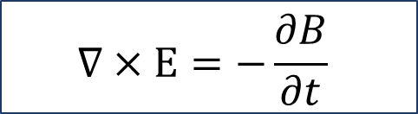
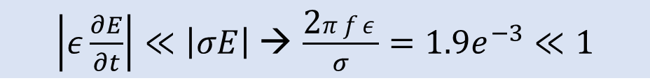
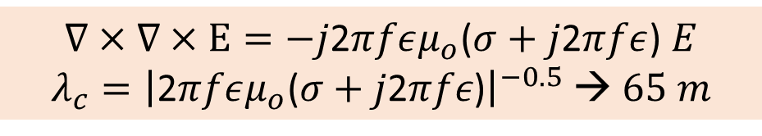
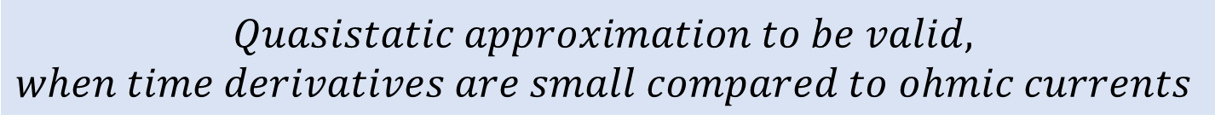
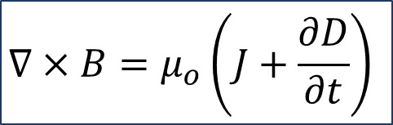
Neural generation of electromagnetic field
Maxwell’s equations and continuity equation help
to calculate the E and B of the brain tissue
when conductivity and electric current are known
$E=E\left(r\right)\exp\left(jwt\right); σ=0.3$ $Ω^{−1}$ $m^{−1},ε=105ε_{ο},$ $f=100Hz$
$$∇×B=μ_{ο}\left(J+\frac{∂D}{∂t}\right)$$
$\left|ε\frac{∂E}{∂t}\right|≪\left|σE\right|$→ $\frac{\text{2}πfε}{σ}=1.9e^{−3}≪1$
$$Quasistatic approximation to be valid, when time derivatives are small compared to ohmic currents$$
$$∇×Ε=−\frac{∂B}{∂t}$$
$∇×∇×Ε=−j\text{2}πfεμ_{ο}$($σ+$ $j\text{2}πfε$) $E$
$λ_{c}={\left|\text{2}πfεμ_{ο}\text{(}σ+j\text{2}πfε\text{)}\right|}^{−0.5}$ → $65 m$
$$Contribution of time derivative magnetic field to E is small$$
Notes:
Get about what is input and output

Slide 18
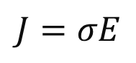
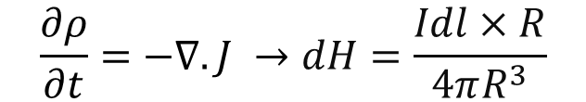
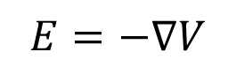
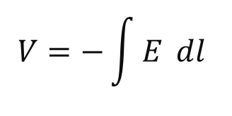
Forward/Inverse problem
Calculating the magnetic field and electric field from known primary current and conductivity distribution of head
Condu-ctivity
E (or) V
B
Prepare the slide better
$$\frac{∂ρ}{∂t}=−∇.J →dH=\frac{Idl×R}{4πR^{3}}$$
$$V=−\int{E }dl$$
$$J=σE$$
$$E=−∇V$$
Current dipole
E (or) V B
Inverse problem is estimating the current source (Dipole) with help of measured distribution of magnetic field
Primary current distribution from either B=0, E=0 or both

Slide 19
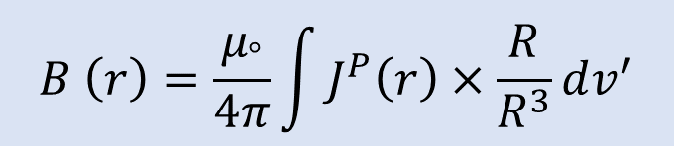
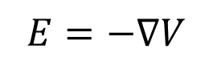
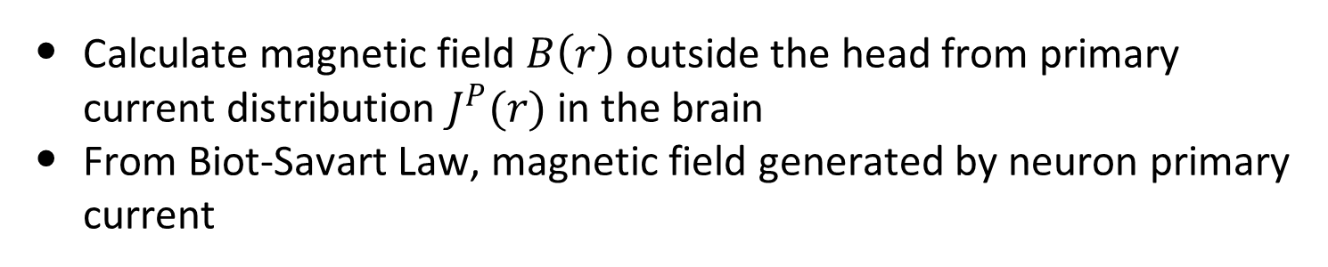
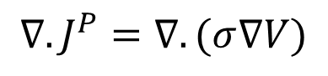
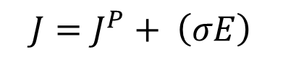
Forward problem
Calculate magnetic field $B\left(r\right)$ outside the head from primary current distribution $J^{P}(r)$ in the brain
From Biot-Savart Law, magnetic field generated by neuron primary current
$$B \left(r\right)=\frac{μ_{°}}{4π}\int{J^{P}\left(r\right)}×\frac{R}{R^{3}}dv^{′}$$
From quasistatic approximation $∇.J=0$
$$J=J^{P}+ \left(σE\right)$$
$$E=−∇V$$
$$∇.J^{P}=∇.(σ∇V)$$

Slide 20
Inverse problem
Estimating the cerebral current source underlaying a measured distribution of the magnetic field
The current distribution inside a conductor cannot be retrieved uniquely from the knowledge of electromagnetic field outside (Helmholtz 1853)
Primary current distributions are
Magnetically silent (B=0 outside conductor), spherically symmetric conductor/radial dipole
Electrically silent (E=0 outside conductor), current loop
Both
Update the slide
Understand the slide
Notes:
Add equations

Slide 21
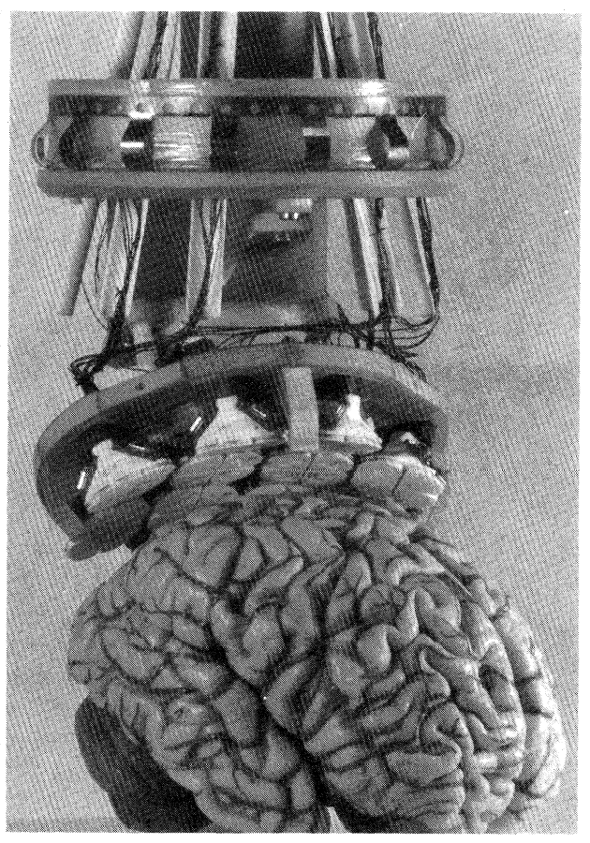

Gradiometer
Gradiometer has compensation coil (upper) and pickup coil (lower)
Pickup coil captures field from source
Nano Ampere range
Understand the x and y axis
A simple wire loop is a magnetometer
Noise cancellation of external field can be done by using same coil cross section area with oppositely oriented winding
24 channel 12-2 gradiometer was developed in Helsinki university
Notes:
In steady magnetic field gradiometer produce zero current (Gradiometer are opposition)
Variable magnetic field produce net current in gradiometer

Slide 22

Noise cancellation
Far reference sensor (noise)
Op-amp
Near source sensor (source field)
$$Source field = (Source field + Noise) –(Noise)$$
Output voltage of an amplifier $Vo=Ad Vd+Ac Vc$
Differential mode differential amplifier $Vd=V1−V2$
Common mode differential amplifier $Vc=\frac{(V1+V2)}{2}$

Slide 23
Contents
Motivation
Introduction
Human brain
Examples of Neuromagnetic fields
Neural basis of magnetoencephalography
Neural generation of electromagnetic fields
Forward and inverse problems
Instrumentation for magnetoencephalography
Ultrasensitive multiferroic sensor
Interfacial perpendicular anisotropy between oxide and ferromagnet
Demonstration of ultrasensitive piezoelectric-magnetostrictive sensors
Instruments
Sputtering
Vibrating sample magnetometer
Stress and strain machine
Electromagnet
Ultrasensitive measurement instruments

Slide 24


Multiferroic materials and composites
Multiferroic materials
P
M
Multiferroic
H
BiFeO₃
E
Ferroelectric
Multiferroic
and magnetoelectric
Ferromagnetic
$$\boxed{α_{ME}=μ_{0}\frac{∂M}{∂E}}$$
P, M
Multiferroic composites
E, H
Terfenol-D, FeGa
Magnetostrictive
PZN-PT, PMN-PT
Piezoelectric
Strain
$$\boxed{α_{ME}=μ_{0}\frac{∂M}{∂σ}\frac{∂σ}{∂E}}$$
3500 Oe → 6 kV/cm, PZN-PT/Terfenol-D
Liu, M. et al., J. Appl. Phys. 112, 063917 (2012)
Notes:
lead zinc niobate-lead titanate (PZN-PT), lead magnesium niobate-lead titanate (PMN-PT)

Slide 25



Multiferroic materials
Multiferroic materials can have intrinsic magnetoelectric coupling
E
Problems at room temperature
$$\boxed{α_{ME}=μ_{0}\frac{∂M}{∂E}=\frac{∂P}{∂H}}$$
Piezoelectricity
P
Issues for
technological applications
Magnetoelectricity (intrinsic)
Room-temperature operation
Not enough magnetoelectric coupling
$$ε$$
M
$$σ$$
H
Magnetostriction
Notes:
Here, E H and sigma are electric field, magnetic field and stress, respectively and they can be applied externally
P M and epsilon are polarization, magnetization and strain, which are macroscopic observables
Here they can be intrinsic coupling between E and H but there are issue for technological applications

Slide 26



Multiferroic composites
E
Multiferroic heterostructures
Magnetostrictive
Piezoelectric
Strain
Piezoelectricity
P
Enhanced magnetoelectric
coupling by strain
Magnetoelectricity (intrinsic)
$$ε$$
M
Stress-mediated
$$\boxed{α_{ME}=μ_{0}\frac{∂M}{∂σ}\frac{∂σ}{∂E}}$$
$$σ$$
H
Magnetostriction

Slide 27







Magnetostriction
Magnetostrictive Material : Certain ferromagnetic specimen changes its shape (strain$ε$:$∂l/l$) during the process of magnetization
Magnetostrictive Anisotropy ↔ Stress Anisotropy
$λ:$ Magnetostriction Co-efficient
$$−\frac{3}{2}λ σ Ω \cos^{2}θ$$
$$σ:Stress$$
$$Ω:Volume$$
Cobalt:
$$\frac{3}{2}λ=−30×{10}^{−6}$$
FeGa:
$$\frac{3}{2}λ=150×{10}^{−6}$$
$$σ=Yε=Yd\frac{V}{t}$$

Slide 28





Multiferroic composites Voltage vs stress anisotropy
V_{in}
$$ε_{piezo}=d_{piezo}×\left(\frac{V_{in}}{t_{piezo}}\right)$$
$$ε_{mag}≃ε_{piezo}$$
$$σ=Yε_{mag}$$
Magnetostrictive
Piezoelectric
t_{piezo}
strain transfer
Choose piezoelectric layer with high de-coefficient
Y: Young’s modulus
Magnetostrictive layer
with high $λ_{s}Y$
$$E_{stress}=−\frac{3}{2}λ_{s}σΩ\cos^{2}{θ}$$
$$d=3000 pm/V$$
$$Y=250×{10}^{9} Pa$$
$$t=100 nm$$
$$V=50 mV$$
Stress Anisotropy (for FeGa):
$\frac{3}{2}λ σ Ω \cos^{2}θ$
$=2.4×{10}^{−18} J$ (max.)

Slide 29








Magnetic anisotropy
Potential energy
$$Ebarrier$$
θ (degree)
$φ$ (degree)
$$θ={180}^{o}$$
$$θ=0^{o}$$
$E=\frac{1}{2}μ_{o}M_{S}H_{K}Ω\sin^{2}θ$
$$E(θ,φ)={\frac{1}{2}μ}_{0}M_{s}\left[H_{k}+H_{d}{Cos}^{2}φ\right]Ω{Sin}^{2}θ$$
$$H_{K}:Coercive field$$
$$Ω: Volume$$
Bulk
Interface
CoCrPt (6nm)
MgO(0.8nm)
CoFeB
t_{CoFeB} < 1.3 nm
In-plane shape anisotropy
Perpendicular anisotropy
Notes:
Iron, Cobalt. Nickel
CrCoPt (6nm)
Magnetic anisotropy: The energy of a magnetic material is different in different direction(?)

Slide 30













Potential landscape of in-plane anisotropy
X-axis
Potential energy
Z-axis
Y-axis
θ (degree)
x-axis
$φ$ (degree)
$$φ$$
$$Easy axis$$
$$θ{=0}^{o},{180}^{o}$$
$$θ$$
Out of plane energy barrier
goes higher at $φ$ $={90}^{o}(?)$
Focus on yellow text box
z-axis
$$Hard axis$$
$$θ=90^{o}$$
y-axis
$$N_{d−xx}+N_{d_{−}yy}+N_{d−zz}=1$$
$E=\frac{1}{2}μ_{o} H_{K} M_{S} Ω\sin^{2}θ$
${ N}_{d}\left(θ,φ\right)$= $N_{d−xx}\sin^{2}θ\cos^{2}φ$+ $N_{d_{−}yy}\sin^{2}θ\cos^{2}θ$ +
$N_{d−zz}$ $\cos^{2}θ$(?)
$$E_{shape}\left(θ,φ\right)=\frac{1}{2}μ_{o}M_{s }^{2}Ω{ N}_{d}(θ,φ)$$
$$Ms=8×{10}^{5}A/m$$

Slide 31









Perpendicular anisotropy
X-axis
$$E_{shape}\left(θ,φ\right)=\frac{1}{2}{ μ}_{0 }M_{s }^{2}Ω{ N}_{d}\left(θ,φ\right)$$
Z-axis
$$H_{k}=\left(N_{d_{−}yy}−N_{d_{−}zz}\right)M_{s }$$
$$H_{d}=\left(N_{d_{−}xx}−N_{d_{−}yy}\right)M_{s}=0$$
$$N_{d−xx}+N_{d_{−}yy}+N_{d−zz}=1$$
Y-axis
x-axis
$$E_{shape}\left(θ,φ\right)=\frac{1}{2}{ μ}_{0 }M_{s}\left[H_{k}+H_{d}{Cos}^{2}φ\right] Ω{ Sin}^{2}θ$$
$$φ$$
z-axis
$$H_{PMA}{=H}_{k}+H_{crystalline}+H_{interface}$$
$$θ$$
y-axis
$$E_{PMA}\left(θ\right)={\frac{1}{2}μ}_{0 }M_{s}{ H}_{PMA} Ω\sin^{2}{θ}$$
$$Easy axis$$
$$θ{=0}^{o},{180}^{o}$$
$$Hard axis$$
$$θ=90^{o}$$
Notes:
1. Change figure

Slide 32






H_{y} vs θ_{min}
Applied field along hard axis (y-axis)
$$E=\frac{1}{2} μ_{0}M_{s}H_{k}\sin^{2}{θ}−μ_{0}M_{s}H_{y}\sin{θ}$$
Applied field along easy axis (z-axis)
$$E=\frac{1}{2} μ_{0}M_{s}H_{k}\sin^{2}{θ}−μ_{0}M_{s}H_{Z}\cos{θ}$$
X-axis
Easy axis and hard axis make separate slides
Z-axis
Y-axis
$$Easy axis$$
$$θ{=0}^{o},{180}^{o}$$
x-axis
$$φ$$
$$θ$$
z-axis
y-axis
$$Hard axis$$
$$θ=90^{o}$$
$\frac{ⅆE}{ⅆθ}=0$, ${ θ}_{min}=\sin^{−1}\left(\frac{Hy}{H_{k}}\right)$
Notes:
Easy axis applied magnetic field at theta = 0 degrees
Hard axis applied magnetic field at theta = 90 degrees

Slide 33




Applied magnetic field along easy axis
X-axis
Easy axis and hard axis make separate slides
Z-axis
Y-axis
$$Easy axis$$
$$θ{=0}^{o},{180}^{o}$$
x-axis
$$φ$$
$$θ$$
z-axis
y-axis
Applied field along easy axis (z-axis)
$$E=\frac{1}{2} μ_{0}M_{s}H_{k}\sin^{2}{θ}−μ_{0}M_{s}H_{Z}\cos{θ}$$
Notes:
Easy axis applied magnetic field at theta = 0 degrees
Hard axis applied magnetic field at theta = 90 degrees

Slide 34


Applied magnetic field along hard axis
X-axis
Easy axis and hard axis make separate slides
Z-axis
Y-axis
x-axis
$$φ$$
$$θ$$
z-axis
y-axis
$$Hard axis$$
$$θ=90^{o}$$
Applied field along hard axis (y-axis)
$$E=\frac{1}{2} μ_{0}M_{s}H_{k}\sin^{2}{θ}−μ_{0}M_{s}H_{y}\sin{θ}$$
Notes:
Easy axis applied magnetic field at theta = 0 degrees
Hard axis applied magnetic field at theta = 90 degrees

Slide 35





Interfacial perpendicular anisotropy between oxide and ferromagnet
MgO
Perpendicular anisotropy : Easy axes
is perpendicular to the sample surface and hard axis is in-plane of the sample
Interface
CoFeB
t_{CoFeB} < 1.3 nm
$$N_{d_{−}zz}≫N_{d_{−}yy}≃1 (?)$$
$$k_{i}=1.3 mJ/m^{2}$$
$$\frac{K}{Ω}=\frac{1}{2}{ μ}_{0}M_{s}^{2}\left(N_{d_{−}yy}−N_{d_{−}zz}\right)+\frac{k_{i}}{tCoFeB}$$
Bulk
Interfacial anisotropy
$$\frac{K}{Ω}tCoFeB=−\left(\frac{1}{2}{ μ}_{0}M_{s}^{2}\right)tCoFeB+k_{i}$$
S.Ikeda et al, Nature Vol 9, DOI:10.1038/NMAT2804 (2010)
Notes:
In plane magnetic field is creating an hystersis→ Easy axis
No hysteresis → Hard axis (Magnetic field is saturating)
Interface of piezoelectric
Paper name
Explain the linear curve

Slide 36
Contents
Motivation
Introduction
Human brain
Examples of Neuromagnetic fields
Neural basis of magnetoencephalography
Neural generation of electromagnetic fields
Forward and inverse problems
Instrumentation for magnetoencephalography
Ultrasensitive multiferroic sensor
Interfacial perpendicular anisotropy between oxide and ferromagnet
Demonstration of ultrasensitive piezoelectric-magnetostrictive sensors
Instruments
Sputtering
Vibrating sample magnetometer
Stress and strain machine
Electromagnet
Ultrasensitive measurement instruments

Slide 37
Experimental
Update the slide
Sputtering
Vibrating sample magnetometer
Stress and strain machine
Electromagnet
Magnetic thermal annealing
Ultrasensitive measurement instruments
Magnetic force microscopy

Slide 38


Sputtering
Sputtering is a technique to deposit metals/Insulators on a substrate
Magnetron sputtering : Magnet keeps high density of sputtering ions, leads higher efficiency
Cathodic sputtering : Inelastic collision between Ar⁺ ions and target atoms
DC - Metal deposition
RF - Insulator deposition
Argon gas
v
Chamber pressure
10e-9 mbar with turbo pump
High vacuum allows
sufficient mean free path
Vacuum pump
Notes:
Energies are different with same momentum

Slide 39

Sputtering
Sputtering is a technique to deposit metals/Insulators on a substrate
Magnetron sputtering
Magnet keeps high density of sputtering ions, leads higher efficiency
Inelastic collision between Ar+ ions and target atoms
High vacuum leads sufficient mean free path
Sputtering
DC - Metal deposition
RF - Insulator deposition
Chamber pressure
10e-9 mbar with turbo pump
Targets
Magnetron sputtering
Notes:
Energies are different with same momentum

Slide 40
Sputtering
Sputtering is the process of atoms of a material are ejected from a target by the bombardment of high-energy particles
Ions of sufficient energy must be created and directed towards the surface of a target to eject atoms from the material
Ejected atoms must he able to move freely towards the object to be coated
Why sputter coating with low pressures
To maintain high ion energies
To prevent too many atom-gas collisions after ejection from the target
Sputter coating with high pressures (Reduces deposition rate)
Material undergoes many gas collisions
Material can also be deflected straight back onto the target

Slide 41


Why
Why the mean free path is high at low pressure
B →
A → Current densities are sufficiently high (-1 mAcm-') to make sputtering useful

Slide 42
Direct current sputtering
Sputtering
gas
Target
Vacuum
pump
DC Power supply
Substrate
Metal deposition rate is high with DC sputtering
The positively charged sputtering gas is accelerated towards target
The ejected atoms get deposited on substrates

Slide 43
Radio frequency sputtering
Sputtering
gas
Target
v
Vacuum
pump
RF Power supply
Substrate
The deposition rate is low compare with DC sputtering
In negative half cycle, sputtering gas atoms get attracted by source
In positive half cycle target atoms ejects from the source along with gas atoms and accelerate towards substrate

Slide 44
Diode sputtering
No magnet at the target
Target atoms can move freely in the vacuum chamber
Target atoms are not directly deposited on the substrate
This increases the process time

Slide 45
Reactive sputtering
Reactive gas is introduced along with argon, It reacts with the target atoms to form the desired compound
Oxygen and nitrogen are commonly used
The process suffers from one important drawback, namely target 'poisoning’
The hysteresis curve obtained when a metal target is sputtered in a reactive gas. As the reactive gas flowrate is increased a sudden transition occurs where the compound forms on the surface of the target. The sputtering rate drops and the partial pressure of reactive gas increases ensuring even further target 'poisoning'

Slide 46

VSM (Vibrating Sample Magnetometer)
Highly sensitive magnetic moment measure device over a range of (1.8 - 400 K) and (7 T)
Sample magnetic field cuts the winding and detects the gradient in terms of current
Flux transformer boost the flux
Prepare the presentation
SQUID converts current into voltage
Works on basic principle
Of Faraday’s law
Detection coil (or) Gradiometer
B field
Sample position
Precise measurement depends on better sample centering
Flux transformer
SQUID with electronics
Notes:
Frequency (?)

Slide 47




Sample centering
Second-order gradiometer
$$m=C\sqrt{∆Z\sum_{i=1}^{n}{V_{i}}}$$
Magnetic Dipole
$$L$$
$$∆Z=L/(n−1)$$
L = Scan length
n = No. of data points
V_{i} = Voltage reading at i^{th} point
C = Calibration factor
(Current to voltage ratio)
Magnetic moment
SQUID output
signal

Slide 48

Superconducting magnet
Super conducting magnet wounded in solenoid configuration
Heater ON, Super conducting loop is open
Heater OFF, Super conducting loop is closed
Dewar can evacuated and purged with helium gas
Negligible resistance at less than critical temperature leads, persisting current
Persisting current flows in the circuit

Slide 49













VSM: In-plane rotation
$$E_{shape}\left(θ,φ\right)=\frac{1}{2}{ μ}_{0 }M_{s}\left[H_{k}+H_{d}{Cos}^{2}φ\right] Ω{ Sin}^{2}θ$$
E
E($θ$,$φ$)
$$θ$$
$$φ$$
z
$$θ=0o$$
$$0o≤θ≤{180}^{o}$$
$$φ=90o$$
$$0o≤φ≤{360}^{o}$$
H
z
z
z
z
H
H
H
H
M
M
M
y
M
M
x
y
y
y
y
x
x
x
x
For $θ$ rotation,
rotate sample clockwise
For $φ$rotation,
rotate rod anticlockwise

Slide 50










VSM: Out-of-plane rotation
z
E
E($θ$,$φ$)
M
H
$$θ$$
$$φ$$
y
x
$$θ=0o$$
$$0o≤θ≤{180}^{o}$$
$$φ=0o$$
$$0o≤φ≤{360}^{o}$$
z
z
y
y
H
H
H
H
M
z
Focus on this part
y
x
x
M
H
y
x
x
z
z
M
M
y
x
For $θ$ rotation, tilt the sample by using glass pieces
For $φ$rotation,
rotate sample

Slide 51
VSM results

Slide 52


















Piezoelectric
Polarized by stress
Change the figures
Put in introduction chapter
Piezoelectric materials can be polarized by electric field and mechanical stress
Direct piezoelectric effect : $D = dD∗σ$
Converse piezoelectric effect : $ε =dC∗ E$
+
-
$$ε_{x}$$
$$d_{11}$$
$$d_{12}$$
$$d_{13}$$
$$E_{x}$$
$$ε_{y}$$
$$d_{21}$$
$$d_{22}$$
$$d_{23}$$
$$E_{y}$$
+
-
+
-
$$ε_{z}$$
$$d_{31}$$
$$d_{32}$$
$$d_{33}$$
$$E_{z}$$
+
-
+
-
Polarized by electric field
Hysteresis of piezoelectric material
Converse piezoelectric effect
Notes:
Poled polarity = Applied voltage polarity for strain → Additional expansion

Slide 53





$$k_{i}=1.3 mJ/m^{2}$$
z
$$N_{d_{−}zz}≫N_{d_{−}yy}≃1$$
MgO
Bulk
Interfacial anisotropy
$$tCoFeB<1.3 nm$$
$$\frac{K}{Ω}=\frac{1}{2}{ μ}_{0}M_{s}^{2}\left(N_{d_{−}yy}−N_{d_{−}zz}\right)+\frac{k_{i}}{tCoFeB}$$
y
CoFeB
$$\frac{K}{Ω}tCoFeB=−\left(\frac{1}{2}{ μ}_{0}M_{s}^{2}\right)tCoFeB+k_{i}$$
x
Interface

Slide 54



Stress - strain machine
Deformation (strain $ε$)of material, when Load (stress $σ$) is applied on it
Load cell strain with elongation and compression load
Young’s modulus $Ε=\frac{σ}{ε}=\frac{F/A}{{ΔL}/L}$
Load cell

Slide 55





Strain gauge
Senses material contraction and elongation in terms of resistance
when material is influenced by an external force
$$\frac{∆R}{R}=K_{S}\frac{∆L}{L}$$
($K_{s}=1+2\left|v\right|+\frac{{∆ρ}/ρ}{ε} )\sim 2.02±1\%$
$$v=\left(\frac{Transverse strain}{Longitudinal strain}\right)$$
$$ρ=Resistivity, ε=Strain$$
Triaxial strain gauge
Wheatstone bridge circuit to measure the resistance
$$e_{o}=E\frac{\left(R1+∆R\right) R3−R2 R4}{\left(R1+∆R+R2\right) (R3+R4)}$$
Notes:
Ks = gauge factor (2.1)

Slide 56




Electromagnet
Electromagnet
Current carrying conductor produce magnetic field around it
Flux = No. of turns * input current
Magnetizing the magnetic sample by varying theta with temperature
Hall probe converts the magnetic field into Hall voltage
Magnetic thermal annealing

Slide 57



Magnetic thermal annealing
Thermometers
PC
Thermal annealing setup
Pirani gauge
0.01 mbar
Electromagnet
Heater
Constant current controller
Chiller
Vacuum
pump
Magnetic thermal annealing at 400mT, 400 degrees for 1 hour
Sample
stand
S.Ikeda et al, DOI:10.1038/NMAT2804 (2010)

Slide 58
Differential amplifier

Slide 59
THANK YOU

Slide 60
Magneto-Optical Kerr Effect

Slide 61
Magnetic force microscopy

Slide 62
Electrical potential in the neuron
Releasing transmitter molecules → Change in permeability → Change in membrane potential
Sufficiently depolarized postsynaptic neurons cause action potential
Concise slide on signal propagation
Membrane voltage positive for a short time
+
-
Depolarization
Repolarization
Excitatory synapse
Inhibitory synapse
Na⁺ inflow begins
Na+ inflow ends
K+ outflow becomes dominate

Slide 63


Slide 64
Electrical potential in the neuron
Releasing transmitter molecules → Change in permeability → Change in membrane potential
Sufficiently depolarized postsynaptic neurons cause action potential
Concise slide on signal propagation
Repolarization
Depolarization
Na⁺ inflow begins
Excitatory synapse
Inhibitory synapse
Na+ inflow ends
K+ outflow becomes dominate
Depolarized membrane →Excitatory PSP
Repolarized membrane →inhibitory PSP
Membrane voltage positive for a short time
-
+

Slide 65

Current in neurons
Volume current (?)
Current = 1 e-6 A
Radius = 100 e-6 m
Ohmic current (?)
-
Direction of propagation
Equilibrium membrane
$$J=J^{p}(r)+J^{v}(r)$$
Currents: Bidirectional movement of ions due to chemical gradient at membrane
Primary current: Movement of ions due to chemical concentration gradient
Volume current: Completes loop of ionic flow, so that no buildup of charge on membrane
+
Action potential
Notes:
Positive ions flows along the direction of propagation → Inside the neuron → Ohmic currents flow along the propagation
Relatively Negative ions flows along the direction of propagation → Outside the neuron → Volume currents flow opposite the propagation

Slide 66
Sputtering
Sputtering is a technique to deposit metals/Insulators on a substrate
Improve the slide
Include vacuum pump
Plasma is created at high voltage under high vacuum
Deposition can be controlled by SCCM (standard cubic centimeter per minute) of Ar⁺ gas
Chamber pressure 10e-9 mbar
v
Argon gas
Targets
DC sputtering - Metal deposition
RF sputtering - Insulator deposition
Vacuum pump

Slide 67
Sputtering
Sputtering is a technique to deposit metals/Insulators on a substrate
Magnetron sputtering : Magnet keeps high density of sputtering ions leads higher efficiency
Cathodic sputtering : Inelastic collision between Ar⁺ ions and target atoms
High vacuum allows
sufficient mean free path
Argon gas
v
Chamber pressure
10e-9 mbar with turbo pump
DC - Metal deposition
RF - Insulator deposition
Vacuum pump

Slide 68



Piezoelectric
Piezoelectric materials can be polarized by electric field and mechanical stress
Change the figures
Add matrix terms
Put in introduction chapter
Direct piezoelectric effect : $D = dD∗σ$
Converse piezoelectric effect : $ε = dC ∗ E$
$$D=Charge density$$
$$σ =Applied stress$$
$$ε =Strain$$
$$E=Applied electric field$$
$$d= Coefficient$$
Polarized by stress
Polarized by electric field
Hysteresis of piezoelectric material
Converse piezoelectric effect
Notes:
Poled polarity = Applied voltage polarity for strain → Additional expansion

Slide 69



Slide 70

Magnetic thermal annealing
Magnetic thermal annealing setup
Totally re-visit the slide
What happens to sample with temperature?
Add arrows ?
Add pump picture and learn different kinds pump ?
Add Vacuum level ?
Add electromagnet chiller pic ?
Add sample holder ?
Add magnetic field, time and temperature ?
Pirani gauge
Thermal anneal chamber
Constant current control source
Electromagnet
Heater
It reorients each spin along applied magnetic field
Reorientation of the easy axis in a ferromagnetic material

Slide 71
Magnetic thermal annealing
Totally re-visit the slide
What happens to sample with temperature?
Add arrows ?
Add pump picture and learn different kinds pump ?
Add Vacuum level ?
Add electromagnet chiller pic ?
Add sample holder ?
Add magnetic field, time and temperature ?
Magnetic thermal annealing setup
It reorients each spin along applied magnetic field
Reorientation of the easy axis in a ferromagnetic material

Slide 72
X-Rays diffraction (XRD)

Slide 73
Ultrasensitive measurement instruments

Slide 74
x-axis
$$φ$$
$$θ$$
z-axis
y-axis
Argon gas
Vacuum pump
DC sputtering - Metal deposition
RF sputtering - Insulator deposition

Slide 75
Negative (Cathode)
Sputtering target
Argon sputtering gas
Vacuum pump
Substrate
Ground (Anode)

Slide 76


E
Piezoelectricity
P
Magnetoelectricity (intrinsic)
$$ε$$
M
$$σ$$
H
Magnetostriction

Slide 77


E
Piezoelectricity
P
Magnetoelectricity (intrinsic)
$$ε$$
M
$$σ$$
H
Magnetostriction

Slide 78
I have done
Wafer cleaning, cutting
I have deposited different magnetic metals by sputtering
Measured the sample thickness in SEM
Magnetized the magnetic sample in out off plane and in plane
Anneal the sample at high temperature
I have generated hysteresis curves of those magnetic sample in VSM
Poled the piezoelectric material (PMN-PT wafer) at high voltage
Observed the piezoelectric voltage with applied stress by machine
Observed the strain vs voltage plots

Slide 79
Orientation of current dipole Tangential and radial dipole
Current dipole is an equivalent source of electric field and magnetic fields
MEG is sensitive to the tangential current dipole
EEG can sense all orientation of sources
Theoretically radial dipole produce zero magnetic field on out of a spherical shell
Practically, head is not spherical and all orientation of current dipole can generate magnetic field
Electrically active but magnetically silent
Magnetically active but electrically silent
Radial dipole
Tangential dipole

Slide 80

Currents in neuron
Currents: Bidirectional movement of ions due to chemical gradient
Primary current: Movement of ions due to chemical concentration gradient
Volume current: Completes loop of ionic flow, so that no buildup of charge on membrane
$$J=J^{p}(r)+J^{v}(r)$$
The resultant direction of current flow in neuron is perpendicular to the cortical sheet of grey matter, where the ion diffusion occur
Generated magnetic field is due to both primary and volume currents
Some part of the brain, volume current generate equal and opposite magnetic fields of primary current causes net zero field outside the head (Very complex to understand)
Notes:
Passive current :- Current that generates by absence of action potential
Volume current occur mainly during the action potential→ The current that would be generate to maintain the

Slide 81

z
x-axis
$$φ$$
Magnetization
direction
$$θ$$
$$θ$$
z-axis
y
y-axis
φ
x
When axon hillock reaches the threshold level, electrical impulses propagate from neuron to neuron

Slide 82
Action potential_2
Sufficiently depolarized postsynaptic cell causes action potential
When axon hillock reaches the threshold level, electrical impulses propagate from neuron to neuron
Action potential leads membrane voltage positive for a short time
Repolarization
Na⁺ Inflow ends
K⁺ Outflow becomes dominate
Depolarization
Equilibrium membrane potential -70mV
Na⁺ Inflow begins
Notes:
A group of sufficiently depolarized postsynaptic cell generate higher potential, that causes action potential and potential at axon hillock aswell
When axon hillock potential reaches the threshold limit, electrical impulses propagate from neuron to neuron

Slide 83
Neural basis of magnetoencephalography
Cell body (Soma)
Neuron
Pre-synaptic neuron cell body
Post-synaptic neuron cell
Notes:
Generally we have two hemisphere and four in our brain,
Two hemisphere separated by longitudinal fissure and communicate by carpus callosum (group of neurons)
Four lobes separated by particular fissure and communicate by the neuron, which have the connection between white matter() and grey matter(occupied by the neurons )
____
This is the neuron with axon and this is the cell body
They are lot of other neuron cells connected to the cell body and shown cell signal receiver called dendrites
Electrical voltages generated in the neuron by the chemical gradient

Slide 84
Post-synaptic potential (PSP)
Permeability of membrane changes when transmitter molecules released to synaptic cleft arrive at post synaptic cell
Change in membrane potential leads current flows in interior of postsynaptic cell
Synaptic cleft (50 nm)
Dendrites
Excitatory synapse
Inhibitory synapse
Receptor channels
Neuro transmitter molecules
Opening ion channels through membrane causes flow of ions (K⁺ , Na⁺ and Cl⁻)
Depolarized membrane causes excitatory PSP
Repolarized membrane causes inhibitory PSP
Notes:
Change in membrane potential follows permeability of membrane, permeability change when transmitter molecules released into synaptic cleft
This molecules flow, it arrives at post synaptic cell (Which is dendrites), the receptor channels receive the transmitter molecules this leads electric field and current in flow in interior of postsynaptic potential
Neuro transmitter molecule get membrane depolarize and repolarize, it causes the excitatory synapse and inhibitory synapse

Slide 85
Action potential
-
+
Equilibrium membrane
Action potential

Slide 86
Practically, head is not spherical and all orientation of current dipole can generate magnetic field
Theoretically radial dipole produce zero magnetic field on out of a spherical shell
R
T
Tangential dipole are magnetically active but electrically silent
Radial dipole are electrically active but magnetically silent

Slide 87
Vibrating Sample Magnetometer (VSM)
θ=0º
θ=0º
y
z
y
z
H
x
x
H
M
For Փ variation, rotate rod in anti-clockwise
M
In-plane sample
Perpendicular sample
For θ variation rotate sample in clockwise direction
For θ variation tilt the sample by using glass pieces
Notes:
Magnitude of a circulation of electric field around a closed loop is equal to the rate of change of the magnetic flux through the are enclosed by the loop.

Slide 88


In-plane _ OK
Position shows theta = 0º
Position shows phi = 0º
z- axis
x- axis
y- axis
z- axis
y- axis
x- axis
In-plane theta = 0-180º, phi = 90º
comes when theta = 90º
In-plane phi = 0-360º at theta = 90º

Slide 89







Slide 90


Out-of-plane _ OK
Position shows theta = 0º
Position shows phi = 0º
z- axis
x- axis
y- axis
y- axis
x- axis
-z- axis
Out of-plane theta = 0-180º, phi = 0º
comes when theta = 90º
Out of-plane phi = 0-360º
at theta = 90º

Slide 91



Slide 92
Magnetic thermal annealing
Lattice deformities can degrade material quality
It helps to eliminate structural imperfections
It reorients each spin along applied magnetic field, if the sample has deformed ferromagnetic lattice
Reorientation of the easy axis in a ferromagnetic material
Magnetic thermal annealing setup

Slide 93
Magnetic thermal annealing
Temperature rise time = 20-30 min
Electromagnet run time_1 = 30 min
Electromagnet off time = 50 min
Electromagnet run time_2 = 30 min
Temperature fall time = 20-30 min

Slide 94
PZNPT – Lead zinc niobate lead titanate
PMNPT – Lead magnesium niobate lead titanate
1T=1e4 Oe, 1pT=1e-8 Oe,
3500 Oe - 6 kV
1e-8 Oe – 1.7e-8 kV
V = E*d = 1.7e-8 kV * 0.3 cm = 0.51e-8 = 5 nV

Slide 95


Slide 96
Sputtering
Thermal evaporation → Solids to vapors
Cathodic sputtering → Inelastic collision b/w Ar ions and target atoms
Magnetron sputtering → Magnet keeps high density of sputtering ions leads higher efficiency
Pulsed laser deposition → laser directed at the target to vaporize the target material.
Reactive sputtering → Plasma is activated by reactive gas
Target is negative
Substrate is positive
Argon gas is positive
Magnetron sputtering → Magnet keeps high density of sputtering ions leads higher efficiency
High vacuum allows sufficient mean free path
The average kinetic energy of the ejected atoms depends on the energy, angle and type of incoming ion, and the nature of the target material, and is typically tens of eV.
Notes:
Elastic collision = KE1=KE2 and P1=P1
Inelastic collision = KE1 not equal KE2 and P1=P2

Slide 98
Questions…
Electric field is zero in side the conductor ?
Piezoelectric material d=SE and measurements
Hysteresis single domain and multi domain ()
COMSOL simulation (Point charge done)
Difference between synapses and dendrites
Does the magnitude and direction

Slide 99
To-do
Ac response and units ft/cm--------AC signal
Second Maxwell eq. 2--------------4th eq
Detail understand on neural and signal transmitter------- synapse and receptor
diffusion eq.
install mat lab
P(k)-------------------
post synaptic equations
what is synaps------signal t/f neuron to neuron
Latex-------------
MEG writeup
Sputtering writeup
Matlab package for maxwell
Need to draw own figures
Matlab file upload (m.file)
Use comsol fig. 4(a) and upload
Get comsol table for point source
Focus on INVERSE PROBLEM
Work on Differential AMPLIFIER with Anurag

Slide 100
To do
Remember UNITS of permittivity (faraday/meter), permeability(H/meter)
MEG in Epilepsy
Why do we need to measure gradient in space of magnetic field?
Write a program that can generate Gaussian signal and its derivative as in Fig. 27
Generate a signal with noise and apply averaging filter for smoothing
Read all about white noise
Understand noise co-relation
Understand Fig. 32
Understand sampling neuro magnetic signal
Understand interpolation
Put things in LATEX and discuss
Do line segment in COMSOL
Change the picture in motivation

Slide 101
Current- To do
Understand: Units ft/cm
Understand: Goldman’s equation
MEG presentation: Inverse problem, Noise (moving average filter)
Difference between synapses and dendrites
Slides
Add magnetostriction slide (added)
Piezoelectric simulation
COMSOL simulation - current dipole figures 4 and 5, Generate figures 19, 24 and 25
Strain guage
Get interface anisotropy slide from priyesh
Calculation on sensor (output 5nV) – Take from khritish (added)
Magnetic thermal annealing
Gauss meter

Slide 102
Current - To do
Magnetic shielded chamber
How magnetic shielded room cancels the magnetic field ?
Sputtering
DC sputtering – insulation deposition ?
Working principle ?
What is plasma, different colors of plasma ?
RF magnetron sputtering ?
Units of vacuum, rotary and turbo pump
Reactive sputtering ?
Confocal sputtering ?
Magnet
Sensor has single domain (or) multi domain magnet ?
Stress strain machine
Units of Young's modules (Neuton/m²) ?
Poling condition ?
Different types of load cell, why S type (symmetrical expansion and contraction on both sides )and where to paste the sample ?
Why we need to paste the sample on top of load cell if pooling is along thickness ?

Slide 103

Current –To-do
Strain gauge
Resistance of the wire ?
Value of gauge factor and how to calculate ?
Gauge factor equation ($K_{s}=1+2\left|v\right|+\frac{\frac{∆ρ}{ρ}}{ε} )$
$v=poissons ratio \left(\frac{T}{L}\right); ρ=resistivity ;ε=strain$?

Slide 104
Glass pieces height
Sputtering slides
Understand point charge in COMSOL
Pooling for 30 min at maximum voltage

Slide 105
Q&A
How do you make sensor ?
Vacuum level of sputtering machine and units ?
Why argon gas is used in sputtering ?
What is dendrites ?
How the signal propagate in neuron ?
Membrane of neuron – semi permeable membrane ?
How the diffusion process continues ?
Action potential and post synaptic potential _ Understand the equations ?
How to detect the abnormal activity of the neuron from measured signals ?
Present techniques to measure voltage from head and how your method is different from that ?
Potential divider ?

Slide 106
Q&A
Why electric field is zero in side conductor ?
Continuity equation ?
Why 1.3 nm ?

Slide 107
How does a signal propagate through neuron ?
Activation function in neuron ?
How do we understand the weights and bias in neuron ?
Does threshold voltage depend upon the synaptic cleft ?
Ft/cm understand the units
Do we need lithography for designing the sensor ?
Understand gauss probe axial and transverse ?

Slide 108
Tomorrow work
How do the signals propagate in a neuron ?
Weighted bias in biological neuron ?
Think about magnetic shielded room ?
How to measure earth magnetic fields ?
How do earth magnetic field cancels ?
Magnetic thermal annealing- slide ?
Send sputtering targets and silicon samples to Indore PMN-PT, PZT and FeGa ?
Open vacuum desiccator get 2nm CoFeB sample for VSM ?
Clean the vacuum desiccator top surface
Check whether the resistance is fluctuating or not before VSM ?
Anneal the sample at 500 degrees for an hour
Check the resistance whether it is constant now ( Priyesh )
Record the resistance in data sheet
Do VSM
Do magnetic thermal annealing
Do VSM again
Afternoon work on piezoelectric characterization ?
Measure the strain before poling
Observe the strain of the piezoelectric wafer before pasting on load cell
Paste the wafer on load cell with glue
Observe the strain again
Apply the stress and note
How to depolarize the piezoelectric material and demagnetize the magnetic material ?

Slide 109
Thumb rules
Do not put any thing in slide, that you can not explain

Slide 110
Experimental to-do
Update the procedure on load cell with strain gauge

